Slide 1
In The name of GOD

Slide 2
Management of First Stage of labor
بازآموزی 1402 شیراز

Slide 3
Labor is defined as regular and painful uterine contractions that cause progressive dilation and effacement of the cervix.
The WHO defined normal birth as "spontaneous in onset, low-risk at the start of labor and remaining so throughout labor and delivery. The infant is born spontaneously in the vertex position between 37 and 42 completed weeks. After birth, mother and infant are in good condition.

Slide 4
Although determining whether labor is progressing normally is a key component of intrapartum care, determining the time of labor onset, measuring its progress, and evaluating the uterine, fetal, and pelvic factors that affect its course are an inexact science.
Notes:
اگرچه تعیین اینکه آیا زایمان به طور طبیعی پیشرفت می کند جزء کلیدی مراقبت های داخل زایمانی است،

Slide 5
"Abnormal labor," "dystocia," and "failure to progress" are traditional but imprecise terms that have been used to describe a labor pattern deviating from that observed in most patients who have a spontaneous vaginal birth.
In the 1950s, Emanuel Friedman described criteria for the normal progress of labor these criteria were used for assessment and management of labor for decades.

Slide 6
Stage ① Latent phase , Active phase
Labor Stage ②
Stage ③

Slide 7
Since 2010, several studies have evaluated the normal progress of labor in thousands of patients to establish contemporary criteria .
Most notably, Zhang studied data from the Consortium of Safe Labor, which included over 62,000 laboring patients at 19 hospitals in the United States and provided robust contemporary data.
Although patients included in the contemporary dataset began labor spontaneously, over 45% received oxytocin for labor augmentation and nearly 75 % received epidural analgesia.
Notes:
کنسرسیوم کار ایمن
داده های قوی معاصر

Slide 8
Contemporary criteria are different from those described by Friedman.
The active phase can start at a more advanced cervical dilation, and dilation can be slower than originally described and can still be normal (associated with a high chance of vaginal birth and normal newborn outcome).
This change in the labor curve can be attributed to changes in patient characteristics and obstetric practices:
In contemporary cohort studies, the parturients tended to be more racially diverse, older, and more overweight/obese than Friedman's parturients.
Oxytocin and epidural were utilized more frequently, and episiotomy and instrument-assisted vaginal birth were performed less frequently in contemporary studies than in Friedman's parturients.

Slide 9
These robust contemporary data better reflect contemporary parturients and labor practices than Friedman's initial data, which were based on labors in only 500 nulliparous and 500 parous patients with different maternal characteristics and managed at a single institution by different obstetric norms.
Friedman and Cohen have not accepted the revision of the classic labor curve, arguing that the shape of the contemporary curve may have been influenced by selection biases, confounders, and statistical methods.

Slide 10
The most recent recommendations from ACOG and SMFM and the revised WHO partograph have all incorporated changes based on data from Zhang et al.

Slide 11
Normal progression in induced labors
The latent phase (defined as dilation <6 cm) is significantly longer in patients undergoing induction than in those in spontaneous labor and can take many hours, whereas the active phase (defined as dilation ≥6 cm) and the second stage are not longer.

Slide 12
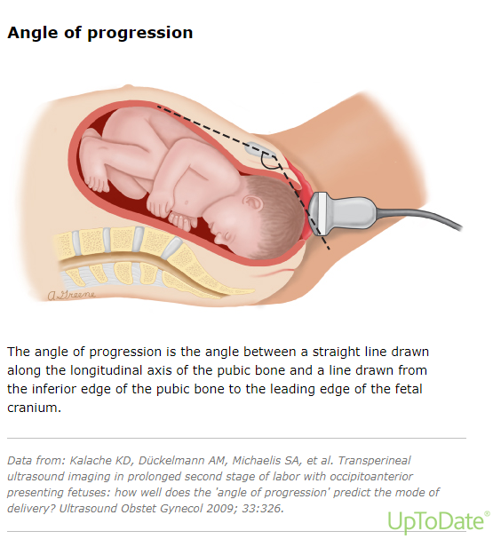
Ultrasound
It can document fetal position and descent, the presence and extent of caput, and rotation (when performed serially) in the 2ed stage.
When the ultrasound is performed at the beginning of the second stage, this technique may be used to predict the likelihood of spontaneous vaginal birth.

Slide 13
Diagnosis and Management of First-Stage Labor
Abnormalites

Slide 14
Risk Factors for Uterine Dysfunction
Neuraxial analgesia can slow labor and has been associated with longer first and second stages of labor, cesarean delivery rates are not higher.
Chorioamnionitis is associated with prolonged labor and uterine dysfunction. augmentation of protracted labor is prudent.
A higher station at the onset of labor is significantly linked with subsequent dystocia. most nulliparas without fetal head engagement at diagnosis of active labor still deliver vaginally, in parous women the head typically descends later in labor.

Slide 15
Increased maternal age.
Maternal obesity lengthens the first stages of labor . C/S rates are higher in this group.

Slide 16
First Stage of Labor :① Latent phase ,② Active Phase

Slide 17
Diagnosis of Latent phase
The diagnosis of latent phase is based on presence of contractions, cervical dilation <6 cm on digital examination, slow cervical change.
There is little consensus regarding absolute diagnostic criteria for either the beginning or end of the latent phase, except that patients with cervical dilation ≥6 cm who are contracting are generally thought to be in the active phase.

Slide 18
Prolong Latent Phase
Friedman/1950s data
In nulliparas, this was 20 hrs and in multiparas, 14 hrs
Contemporary data
In nulliparas was 30 hrs (median 9 hrs)
In multiparas, 24.5 hrs (median 6.8 hours).

Slide 19
Factors affecting the duration of the latent phase
A favorable cervix ( a Bishop score ≥6) at the onset of labors.
Neuraxial anesthesia. the first stage was shorter than those who received systemic opioid.
Abnormal fetal positions, such as OP and transverse position.

Slide 20
Factors without a clear effect on latent phase duration include:
Maternal age
Pelvic capacity
Gestational age
Newborn weight

Slide 21
A longer latent phase duration has also been associated with adverse outcomes other than C/S. included more frequent dystocia diagnosis and related interventions ( oxytocin augmentation, amniotomy, epidural anesthesia) during the active phase or second stage, and risk of chorioamnionitis and OP position in nulliparas.
Notes:
occiput posterior

Slide 22
Should pregnant people in the latent phase be at home or in the hospital?
Generally, the latent phase is best experienced at home because studies report that patients with low-risk pregnancies admitted in the latent phase are more likely to have interventions such as oxytocin augmentation, epidural analgesia, and even C/S.

Slide 23
Some such patients repetitively return to the labor unit and become increasingly tired and frustrated.
It is our practice to offer admission to these patients as this type of latent phase can be physically and emotionally exhausting.
Another common practice is to offer a sedative to help the patient fall asleep at home.
One option is zolpidem 5 mg orally, which results in low but detectable umbilical cord concentrations when taken less than 11 hrs prior to giving birth . Neonatal sequelae are possible but unlikely after a single maternal dose used for this purpose.

Slide 24
Intervention in Latent Phase
Nonintervention is also an option.
Parenteral opioids for therapeutic rest (preferred ) .
Oxytocin augmentation, with or without amniotomy and with or without epidural anesthesia.
Amniotomy NOT advised

Slide 25
After ensuring maternal and fetal well-being, morphine or another opioid.
Morphine 5 to 10 mg IM and IV simultaneously, not to exceed a total dose of 20 mg.
If respirations were not depressed and the contractions were continuing without cervical change after 20 minutes, an additional 10 mg could be given (for patients with obesity, initial and repeat doses were increased by 5 mg) . This was expected to result in 6 to 10 hrs of sleep.

Slide 26
Abnormal Active Phase
The active phase of labor starts at 6 cm ,although some will have begun the active phase before 6 cm.
Abnormality of the active phase of the first stage, include :
Protraction and arrest disorders is independent of parity.
Accurate assessment of adequacy of uterine contractions is required.

Slide 27
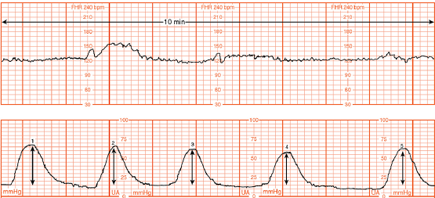
Montevideo units are calculated by subtracting the baseline uterine pressure from the peak contraction pressure for each contraction in a 10-minute window and adding the pressures generated by each contraction.

Slide 28
Protraction Disorders
By Friedman Data :
Protraction has been defined as <1 cm/hr cervical dilation for a minimum of 4 hrs.
In Contemporary data:
Protraction : protracted active phase in nulliparous or parous at ≥6 cm dilation who dilate <1 to 2 cm over two hours.

Slide 29
MANAGEMENT
Protraction Disorders
Oxytocin and amniotomy
Oxytocin augmentation is reasonable even in the absence of documented hypocontractile uterine activity, given that qualitative assessment of uterine activity is imprecise and quantitative measurement is invasive and of unproven benefit.

Slide 30
Amniotomy : as long as fetal descent is sufficient to minimize the risk of cord prolapse.
If the head is not well applied to the cervix, begin oxytocin but delay performing amniotomy.
If oxytocin alone does not result in adequate progress within four to sixhrs, we perform an amniotomy at that time.

Slide 31
These criteria were proposed by both the Society for Maternal-Fetal Medicine and ACOG.

Slide 32
Meta-analyses of randomized trials have shown that the mean duration of labor can be shortened by intervention.

Slide 33
Arrest Disorders
By Friedman Data :
Defined as no dilation for ≥2 hrs
In Contemporary data:
Arrest : in nulliparous or parous with ROM , cervical dilation ≥6 cm, and one of the following:
No cervical change for ≥ 4 hrs despite adequate contractions (assessed qualitatively or objectively defined as >200 MVU
No cervical change for ≥6 hrs of oxytocin administration with inadequate contractions

Slide 34
As long as labor is progressig, either slowly or normally, continue oxytocin at the dose required to maintain an adequate uterine contraction pattern.

Slide 35
Arrest
If an arrest occurs, proceed with a C/S.

Slide 37
Maternal and Newborn outcomes associated with Abnormal
Labor progression

Slide 38
Maternal outcome
first- and second-stage protraction disorders associated with increased risks:
• Chorioamnionitis
• Assisted vaginal birth
• Obstetric anal sphincter injury
• C/S
• Postpartum hemorrhage
• Postpartum urinary retention
• Endometritis
A second stage ≥180 minutes has been associated with a modest increase in risk of spontaneous PTB in the next pregnancy in some studies.

Slide 39
Newborn outcome
Admission to a NICU
RDS
Confirmed or suspected sepsis.
Birth asphyxia-related complications, which progressively increase with duration of second stage

Slide 40

Thank You for Attention

